Slide 1

Non -Linear Optimization
TEAM 6 BAN C
Sana Afreen | Vincent Mostert | Trym Rodal

Slide 2
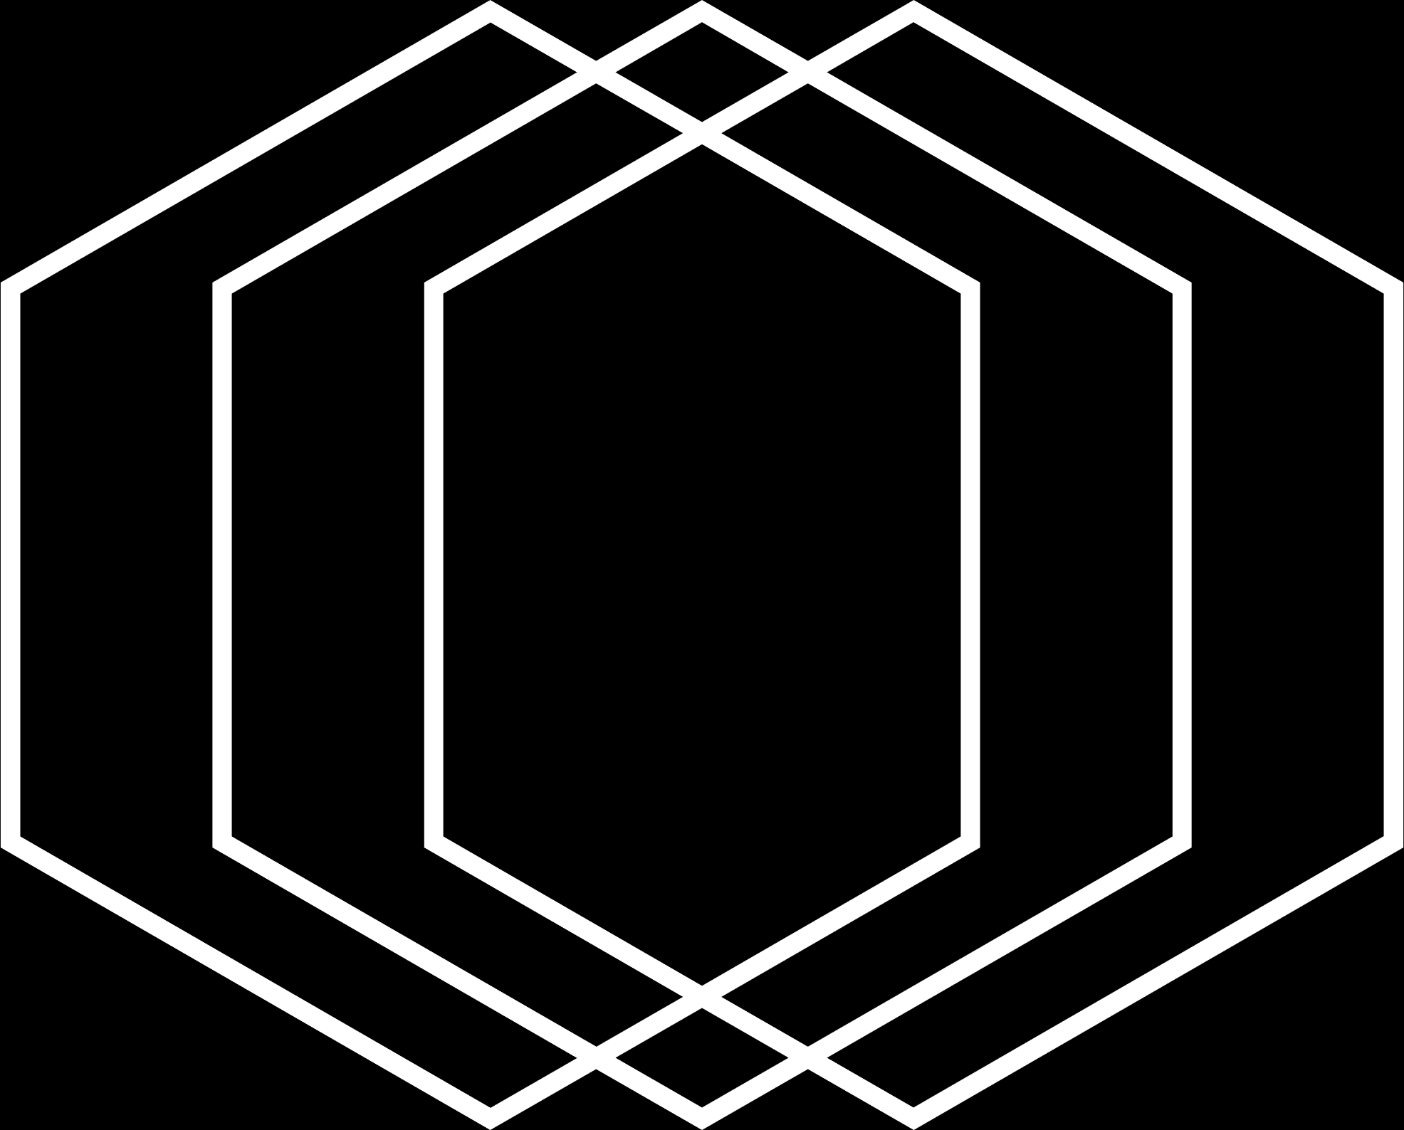

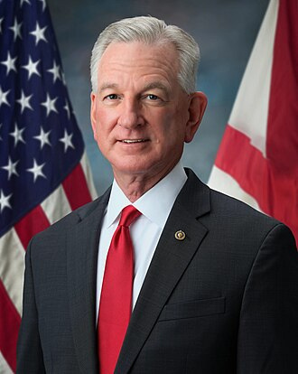

Tommy Tuberville
Alabama Senator
69 years old, 2 Years Senator
Football coach turned Senator
TOP 5 traders (1049 trades)
TOP 3 value investors (~$30 Million)
13% Return on Investment
VOLUME & VALUE
1

Slide 3












CHOSEN STOCKS
2

Slide 4





PORTFOLIO DIVERSITY
POPULAR
UNPOPULAR
INELASTIC
ELASTIC
3

Slide 5



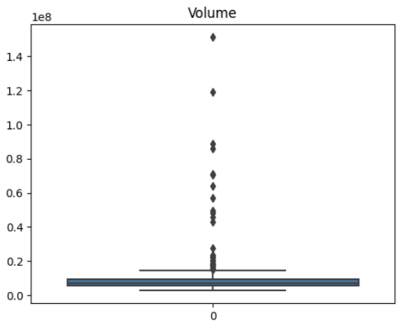
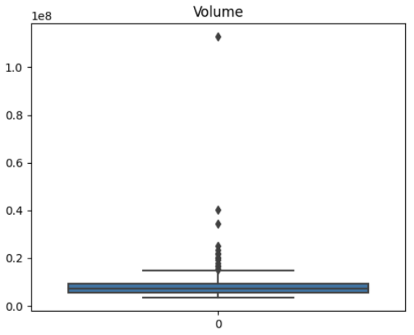

UNIVARIATE HIGHLIGHTS
Average volume of 11.20 million.
Minimum of 2.65 million
Maximum of 151.32 million.
Average volume of 8.64 million
Minimum of 3.32 million
Maximum of 112.84 million.
4

Slide 6

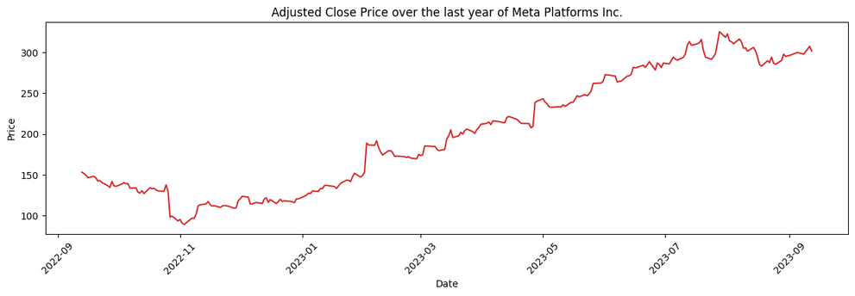
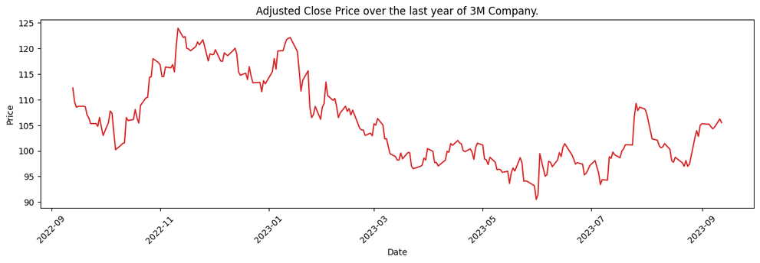

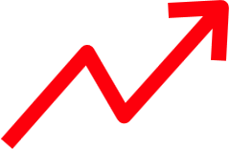

BIVARIATE HIGHLIGHTS
ADJUSTED CLOSE PRICE
5

Slide 7



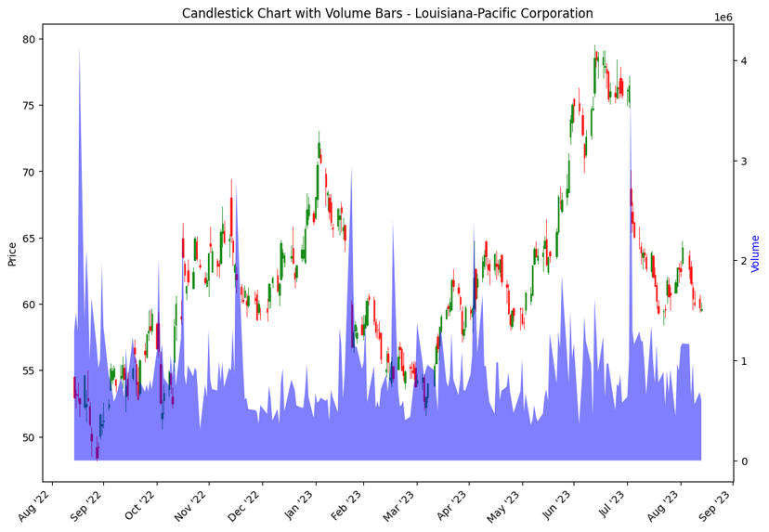
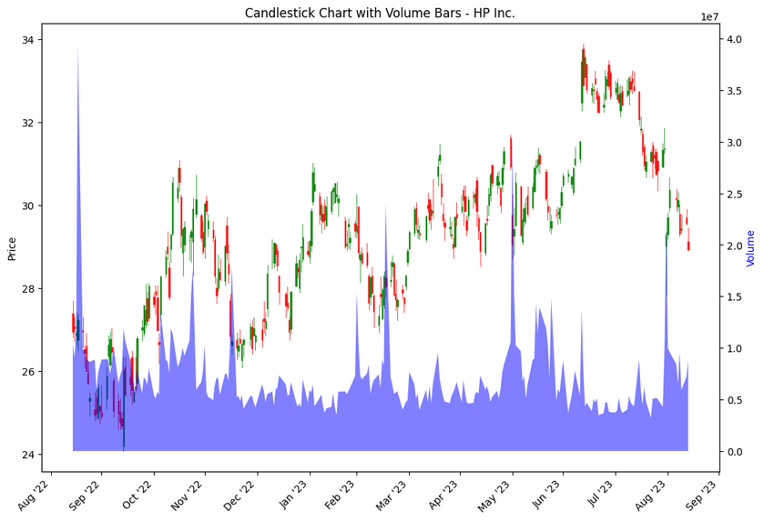

MULTIVARIATE HIGHLIGHTS
More trades before bearish !
--> dumping
More trades before bullish !
--> buying
6

Slide 8

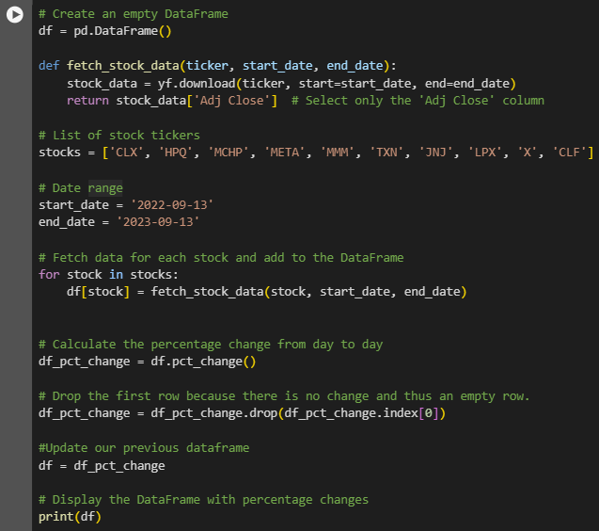
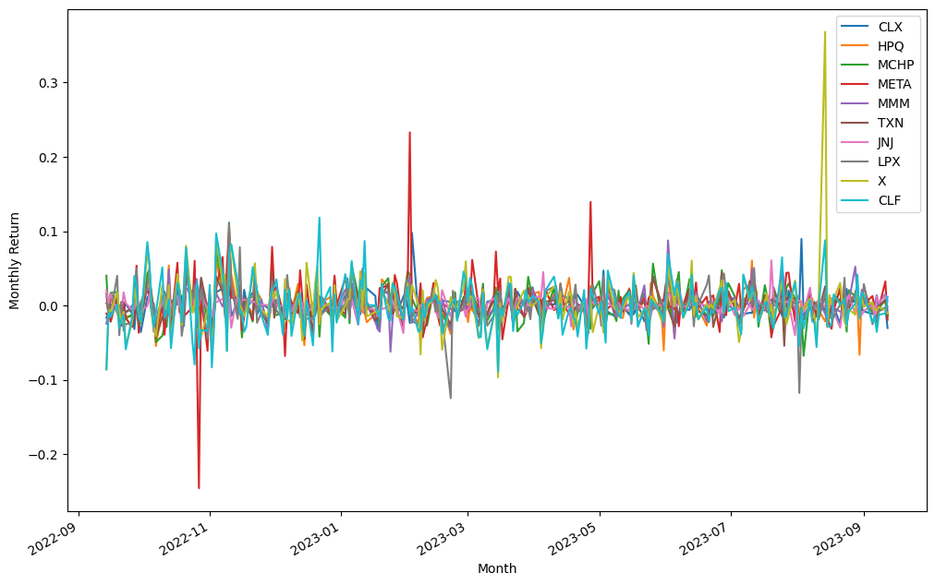

DATA SET CONVERSION
Stock Value Stock return
7

Slide 9


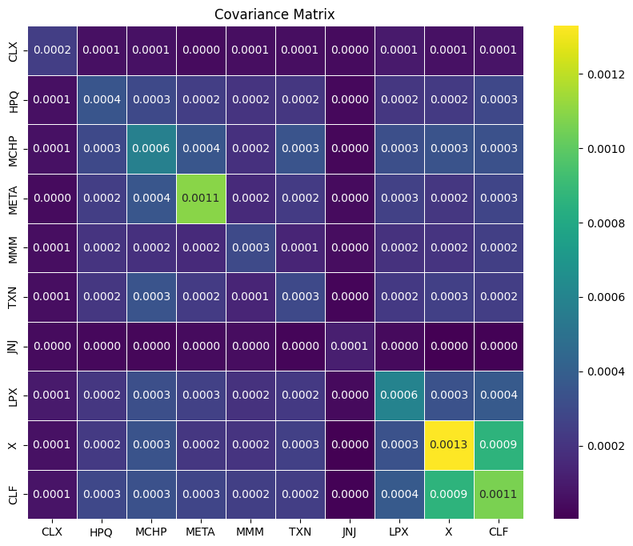
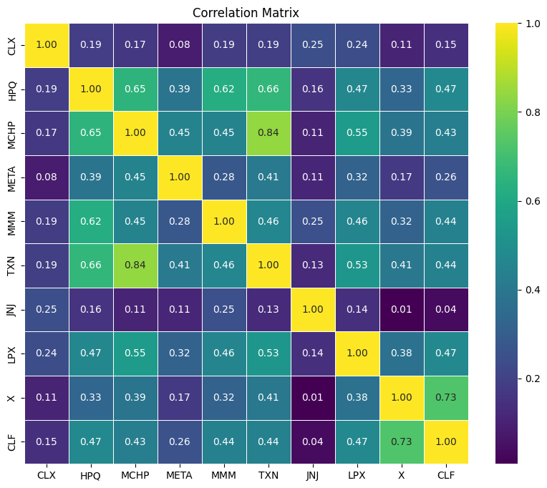
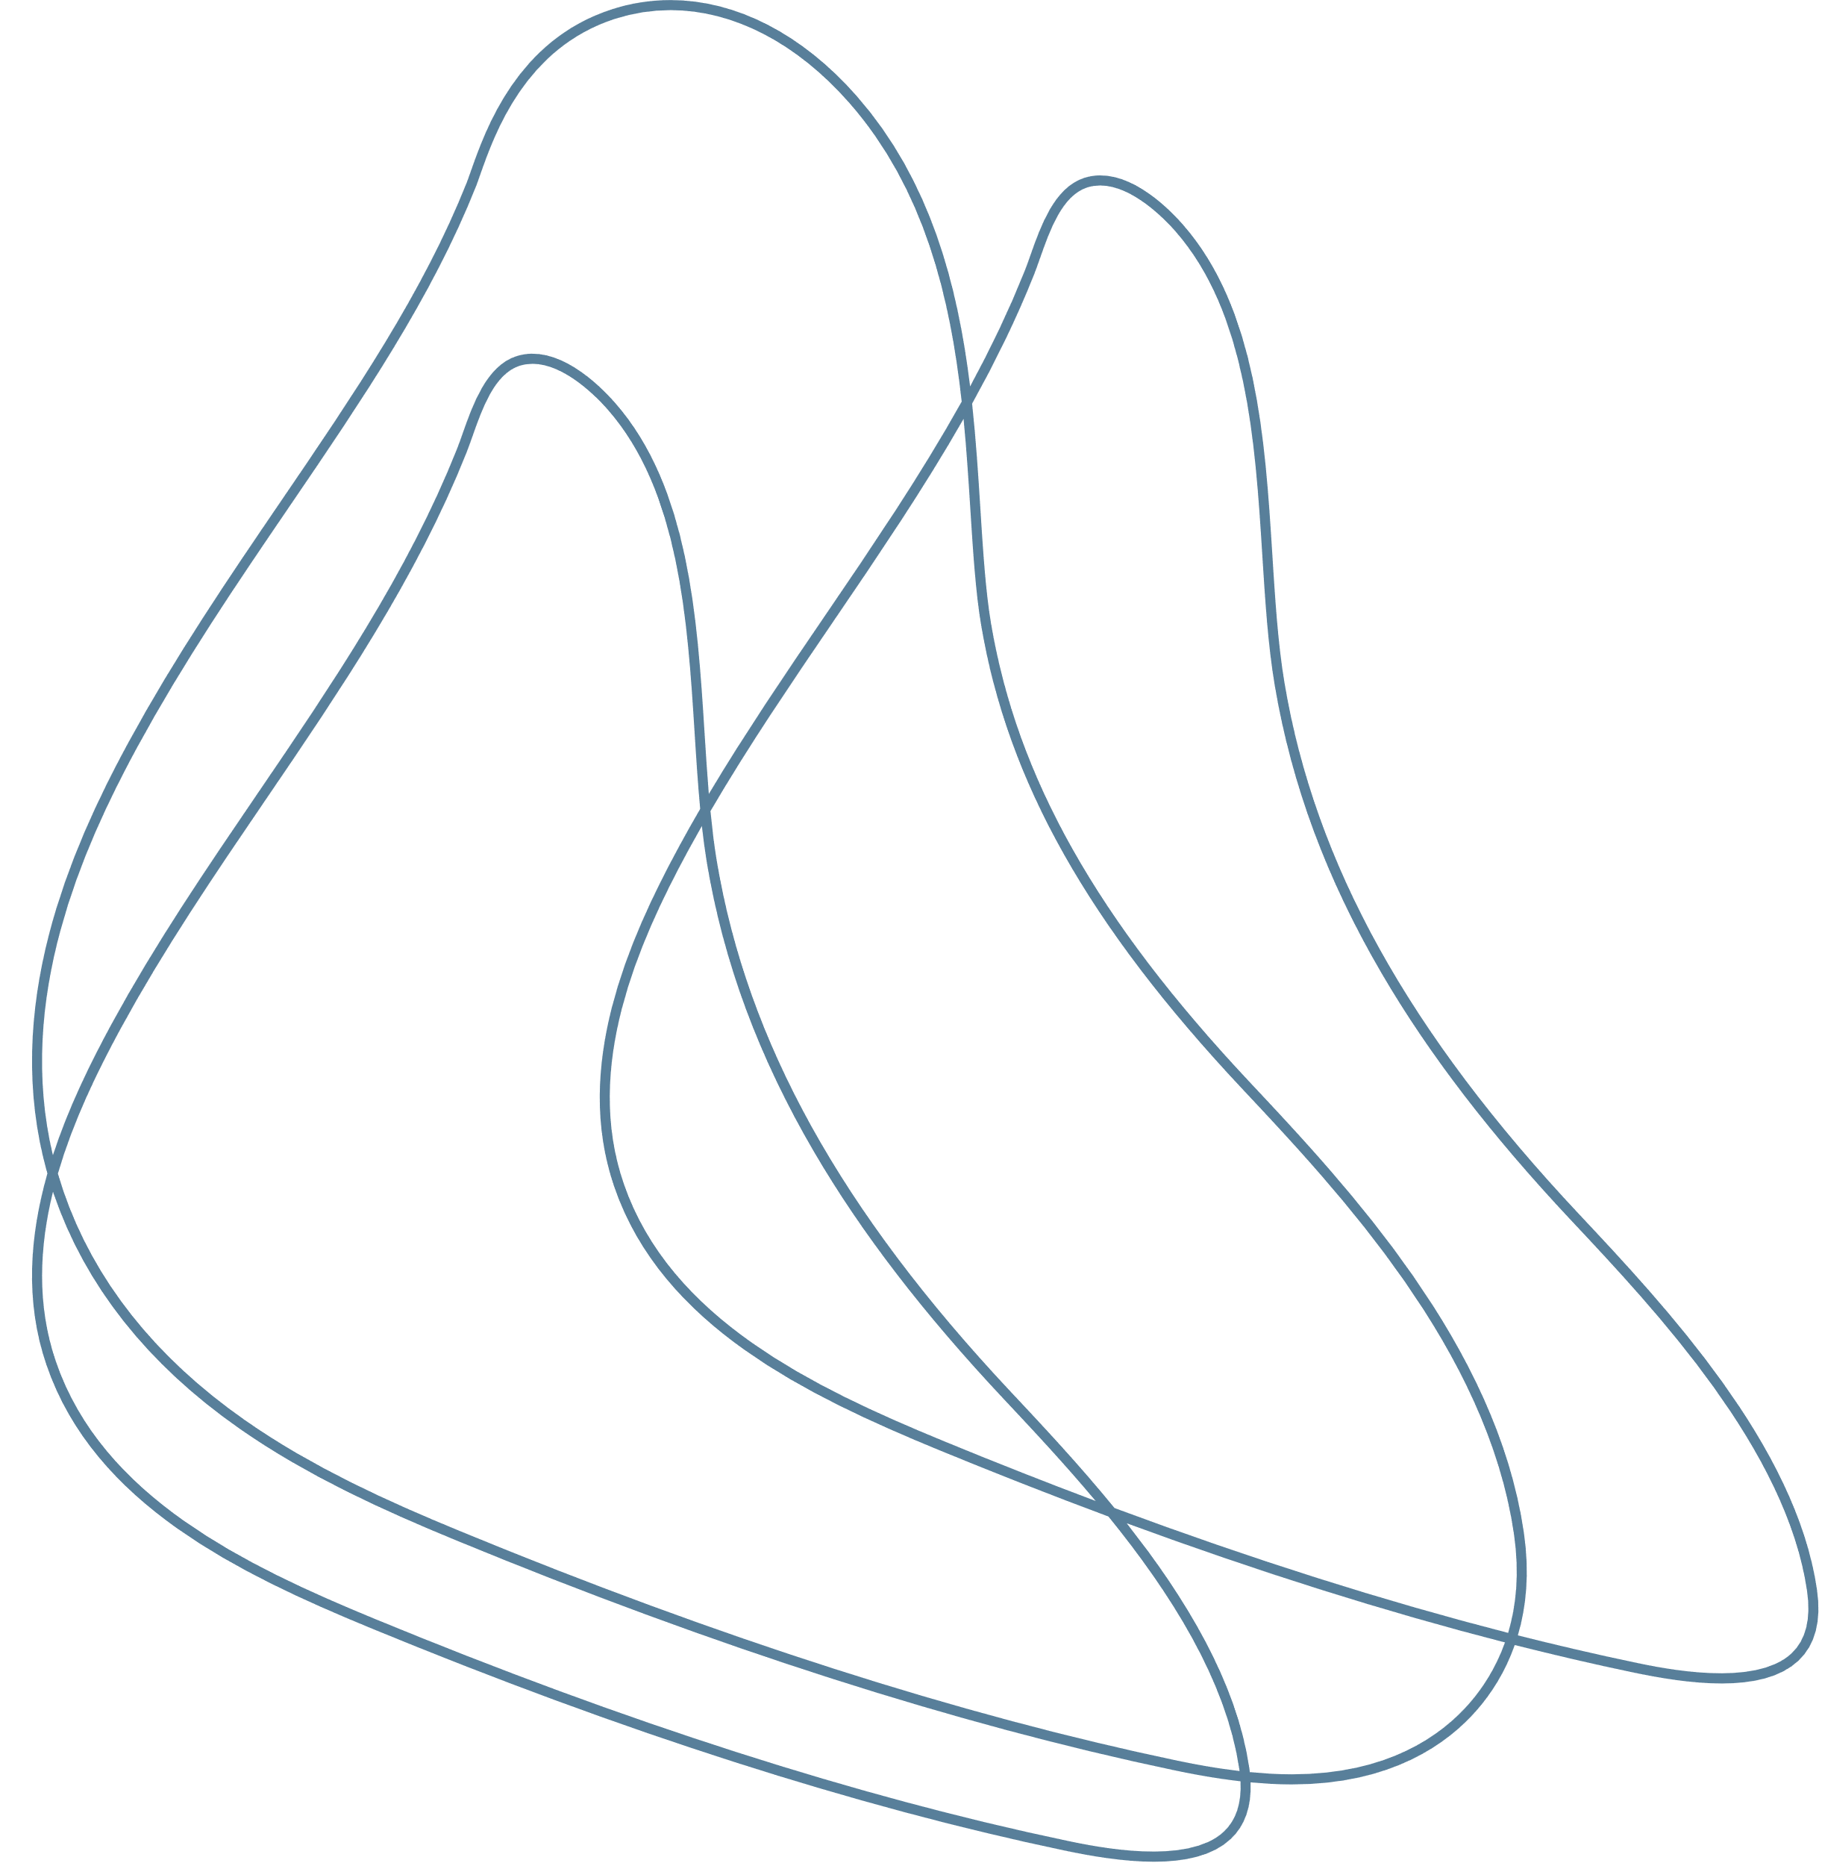
COVARIANCE AND CORRELATION
8

Slide 10


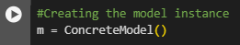
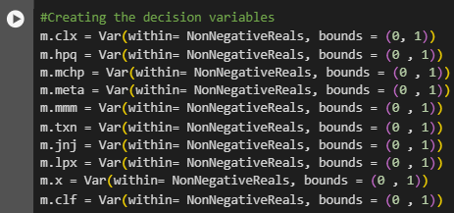
MODEL CREATION
Model instance
Decision Variables
9

Slide 11
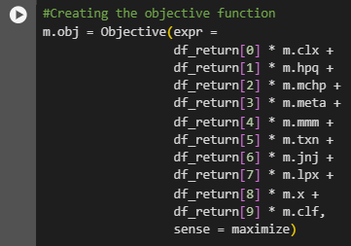
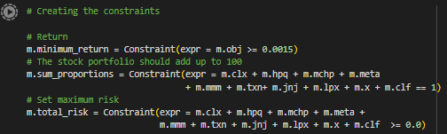
Objective function
Constraints
10

Slide 12
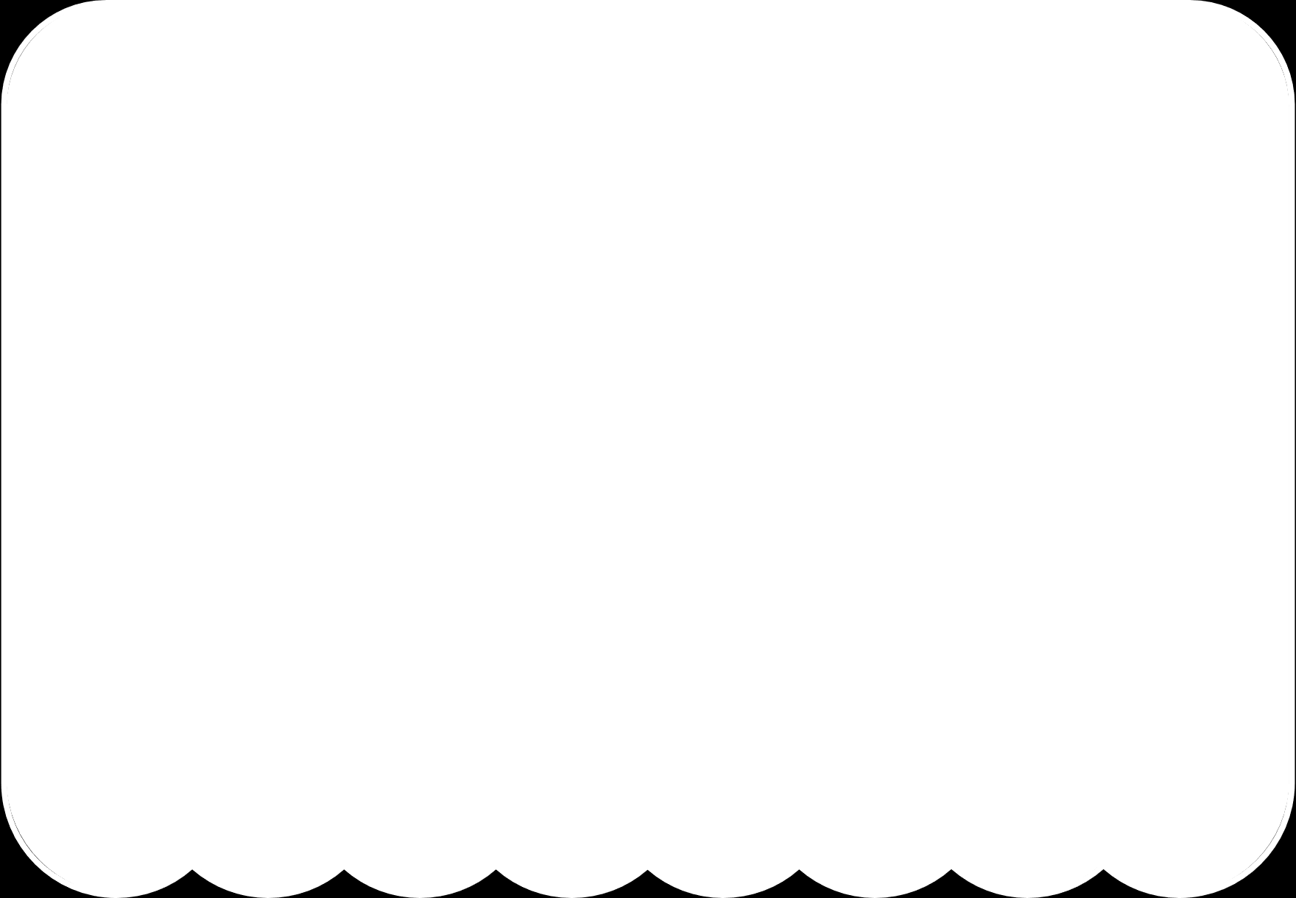



PARAMETERS
Risk: Max 0.15%
Return: Min 0.15%
WHY?
Senator would trade with low risk.
0.15% return is 50% of average trader return.
11

Slide 13
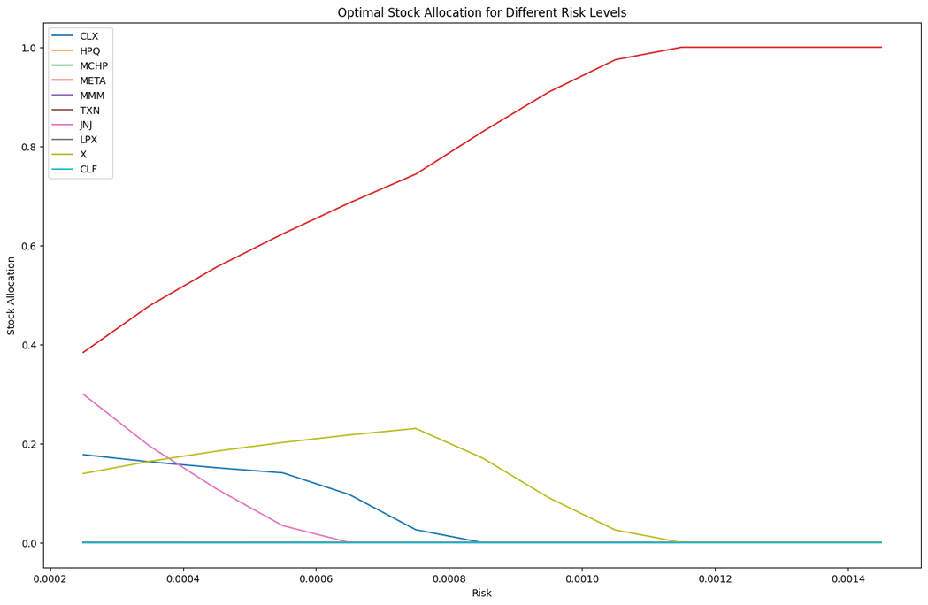
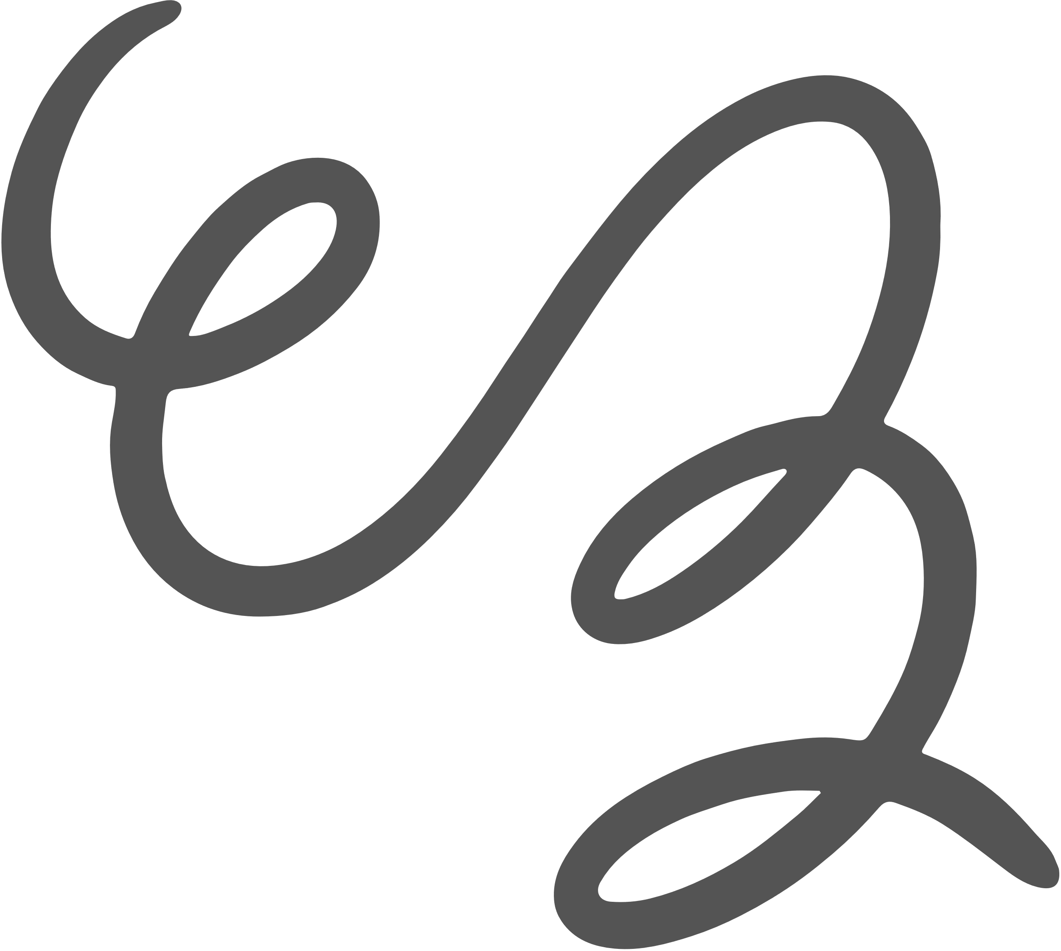
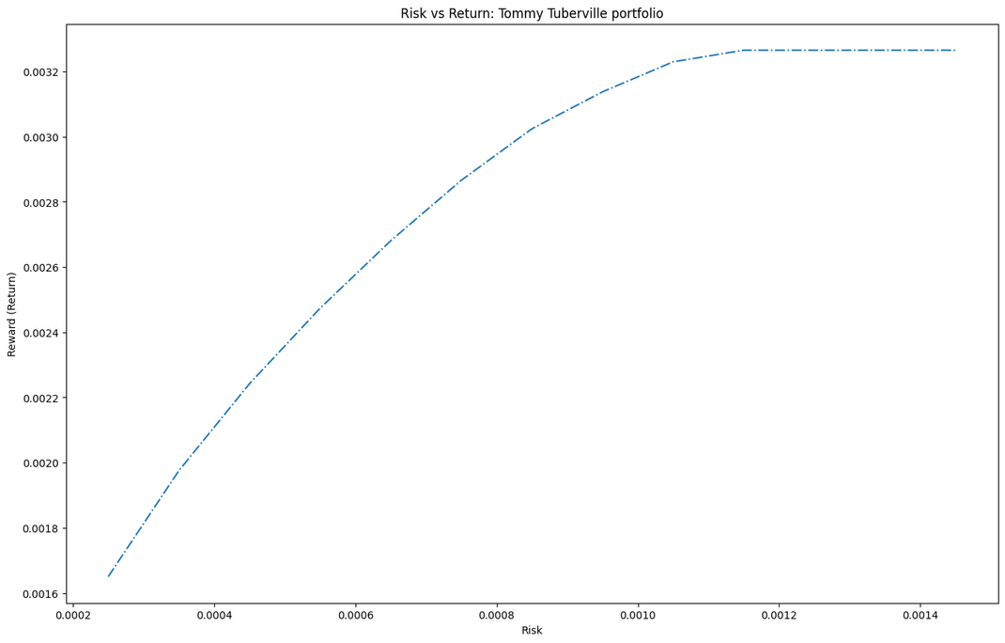
MODEL RESULTS
Lowest risk:
4 stocks: X (15%), CLX (19%), JNJ (29%), META (38%)
Highest risk:
1 stock: META (100%)
Medium risk:
3 stocks: X (5%), CLX (20%), META (75%)
Saturation point at 0.11% risk.
‘Optimal’ risk of 0.11% gives return of 0.325%.
‘Optimal’ not ideal (diversification)
12

Slide 14

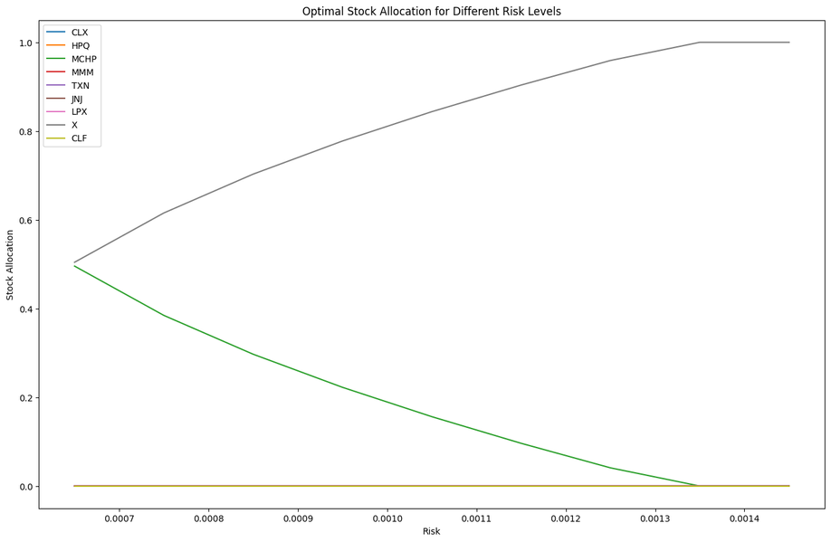
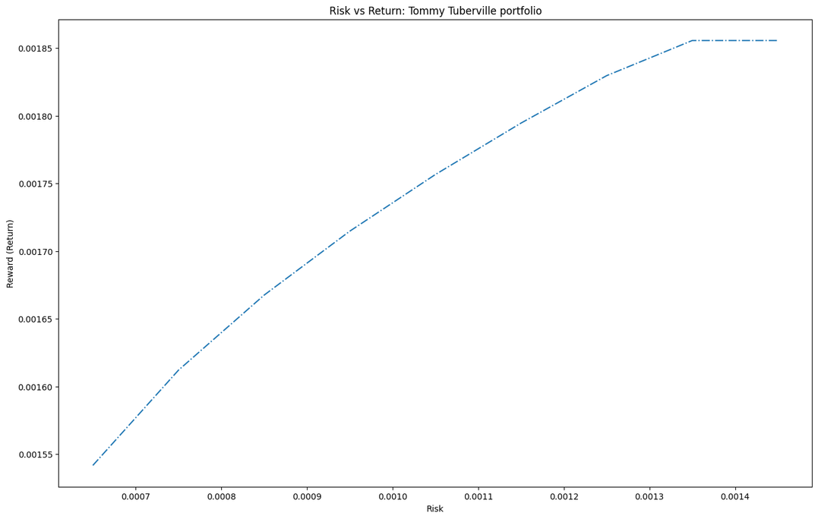

SENSITIVITY ANALYSIS
(Model without META)
Lowest risk:
2 stocks: X (50%), MCHP (50%)
Highest risk:
1 stock: X (100%)
Medium risk:
2 stocks: X (80%), MCHP(20%)
Saturation point at 0.135% risk.
‘Optimal’ risk of 0.135% gives return of 0.185%.
Half the return for more risk.
13

Slide 15






CONCLUSION
Improbable for high return with 10 stocks.
Cannot recreate return we wanted with same stocks as senator
Highly unlikely senator could generate 13%
0.068% risk - 0.27% return, where we would still have 3 stocks.
CORRELATION ≠ CAUSATION
14

